Slide 1
STUDENT FEE REGISTRATION
Submitted By : M. Raghavi
Batch Code : 2021 - 6139
Enrolment No :EBEON0921446719

Slide 2
ABSTRACT
Student Fee Registration application Using Swing JFrame Technology in Core Java And Eclipse IDE for Organizations to enter fee details and Academic details Of the Student for the Admission. By Using This Application we can enter student fee transactions easily.

Slide 3
APPLICATION DESCRIPTION
The student Fee Registration Application is used to make the fee transactions easily for any student in any organization.
In this, Application we use Swing JFrame Technology which in this package we can create all textfields and radiobuttons and choices easily without jsp and xml files.

Slide 4
MODULE DESCRIPTION
After entering all the Fee Details of Student we can perform following Actions as follows:
The series of menus displayed are as follows:
Generate Receipt
Reset the Details
Print the Receipt

Slide 5
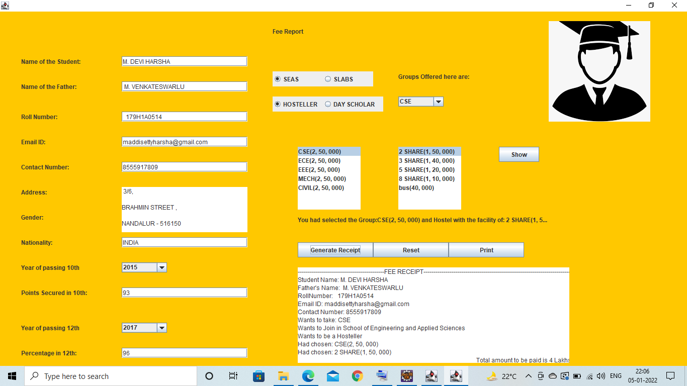
OUTPUT SCREEN

Slide 6
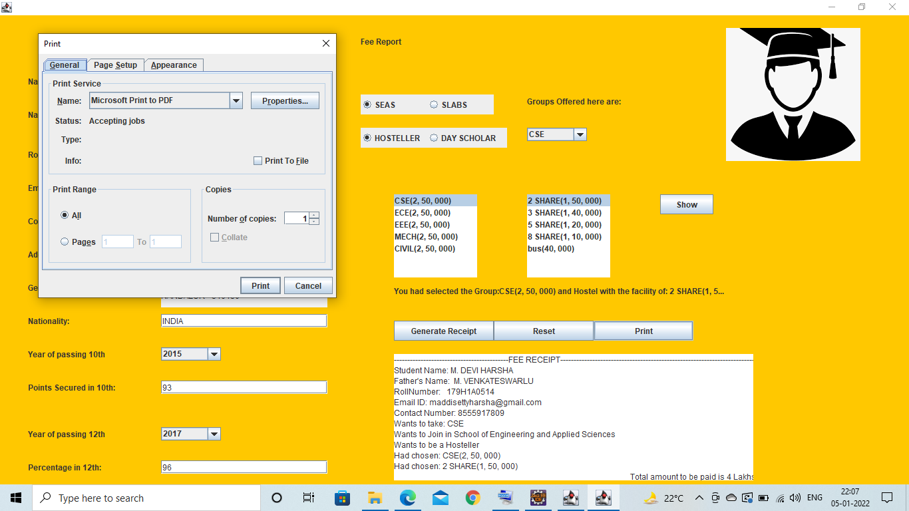

Slide 7
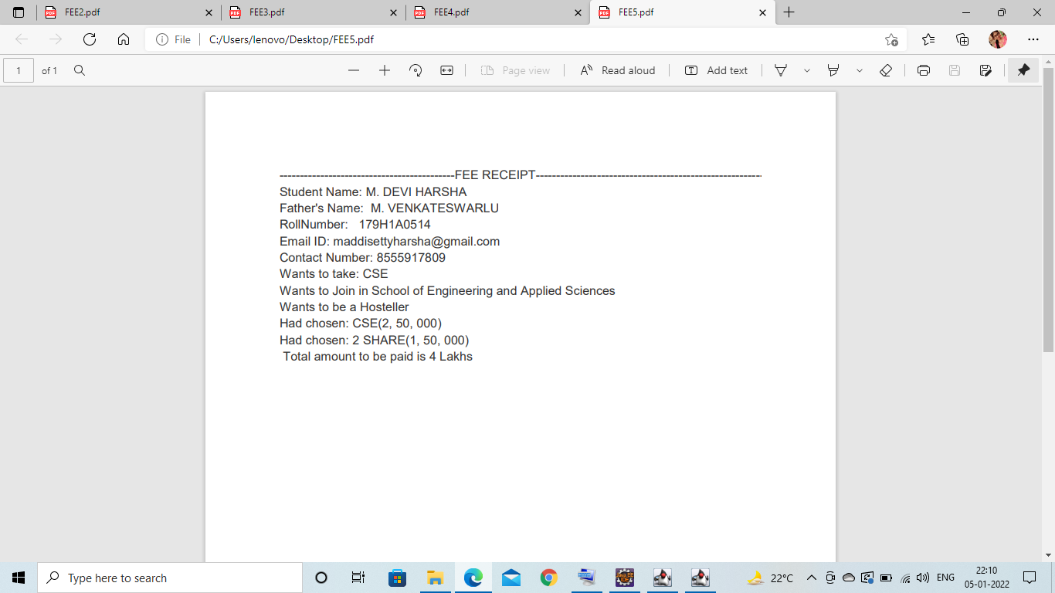

Slide 8
THANK YOU…

